Slide 1
Global warming debates – the reading course
Our emails and phone numbers: course web page.
Course web page: readings, guidance, announcements, check often:
Requirements: attend all course meetings, read the assigned readings for each class, write a one-page summary of the assigned readings before each class (single space, 12pt). In addition, each student should prepare to lead the discussion, with an accompanying presentation, in a few class meetings. Guidance and help regarding these tasks will be provided throughout the term.
Grading: attendance, participation, weekly written reports, discussion-leading presentations.

Slide 2
Writing assignment
Please write a one-page summary of the assigned readings (single space, 12pt), to be submitted via Canvas beginning of class. Please be concise and accurate.
Discuss all assigned papers, summarizing the authors’ position, and the main facts on which it is based.
Discuss the strengths and weaknesses of their observations, analysis and conclusions. Including but not limited to: invalid assumptions, inappropriate treatment of data, conclusions that are not well-based.
Briefly compare and contrast the conclusions of the different reading materials. Conclude with a brief reasoned statement of your own position.

Slide 3
Presentation guidelines - discussion
The purpose of the presentation is one – to induce a discussion. As soon as a discussion develops, you have achieved your goal – do not be concerned with completing your presentation, sit back and relax. Do not feel obliged to answer all questions, let others participate…
Slides:
Start with a brief background/ motivation, not from assigned reading
Show all figures from all assigned papers early in presentation – good way to get a discussion going, because class is familiar with these.
Font – never below 24 points
On each slide: title, graphics, explanation, brief take-home message.
Discuss the weaknesses and strengths of the assigned papers
Conclude with a summary of the debate as represented by the papers
Alternate presenting in class every 1-2 slides, rather than mid-way
About 30-35 slides.
Avoid slides with text and no figures/ graphics (bullet point lists etc),
Never use a slide like this…! ☺

Slide 4
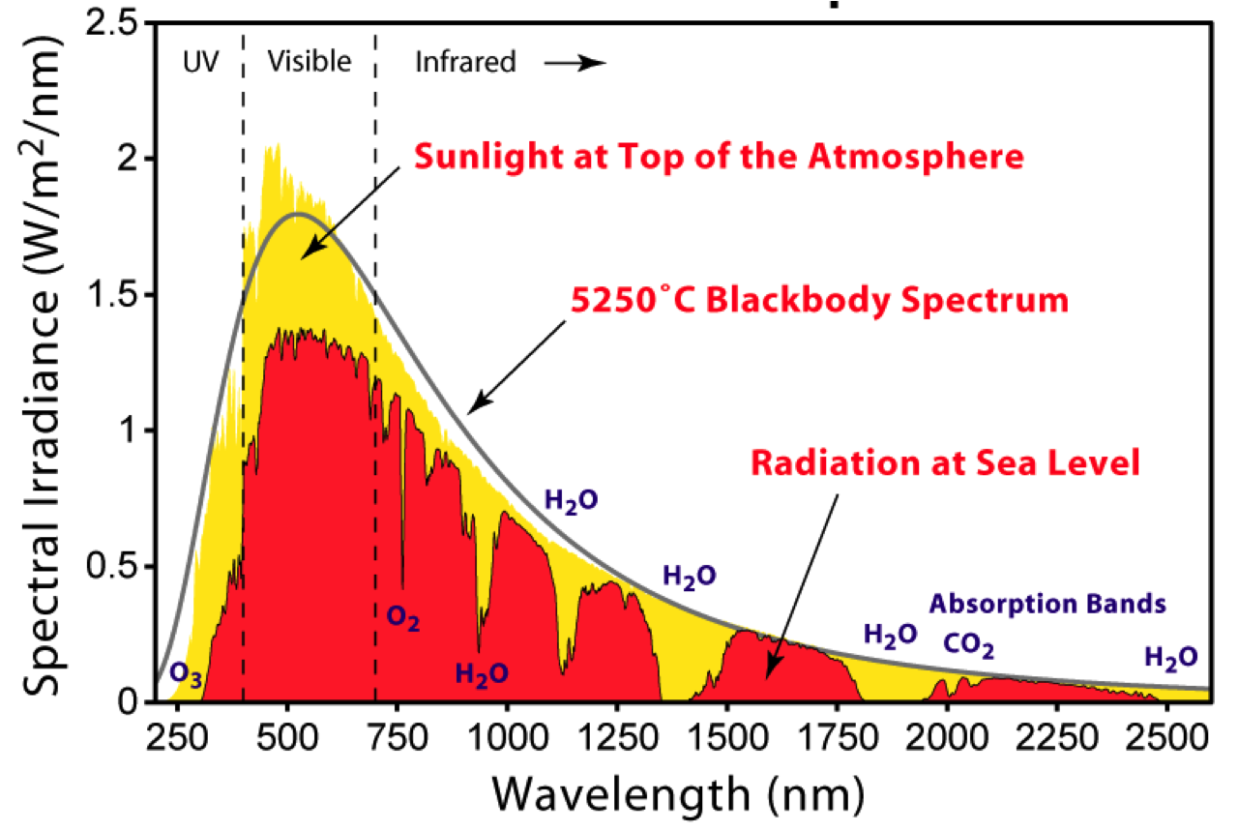
Example of a good slide: A descriptive title
yellow: …
red: …
Black: …
caption, explaining exactly what’s shown in the figure including both axes and all lines, etc
A brief take home message. Everything on slide in 24 points or larger
Notes:
ELIZABETH
Most of the radiation reaches the earth

Slide 5
Presentation guidelines: introduction
The purpose of the 10-minute intro presentation is (1) introduce and motivate next week’s discussion. (2) clarify difficult to understand issues in the reading material, to make it easier for the other students to understand the readings.
Slides:
Six slides, see guidelines for discussion presentation

Slide 6
Another course requirement: Snacks…

Slide 7
A summary of the points made by “The great global warming swindle”

Slide 8
The great global warming swindle: 1/3
We are told that global warming is proved beyond any doubt – lies!
“I believe in global warming, but not that it’s us or CO₂”.
There were period with 10 times as much CO₂, we should see the consequences in the geologic record
None of the major climate changes of the last 1000 years can be explained by CO₂
The current warming is due to coming out of the little ice age (1600)
Medieval warm period (1200) was a time of prosperity
Most warming occurred in the early 20 century, before CO₂ (11:30)
CO₂ forms only a very small part of the earth’s atmosphere (ppm)
CO₂ never drove climate in the past
Nothing special about current climate, Earth temp always changing
CO₂ is a very minor greenhouse gas, much smaller than water vapor
mid-tropospheric warming expected in theory but not found in data ➔ warming happened at wrong time (early 20c) and place (surface)

Slide 9
The great global warming swindle: 2/3
Ice cores show that temperature leads CO₂ by 800 years
Humans are a minute effect relative to the sun…
Solar activity/ sun spots very strongly correlated with temperature
Sun affects cloud formation via the modulation of cosmic rays
In the 70s, experts warned of a global ice age coming soon
Climate models are based on hundreds of assumptions, all it takes is for one assumption to be wrong, and the forecast is useless
All models assume that CO₂ is the main cause for climate change, rather than the sun or clouds.
Warming → smaller EPTD → less storminess, not more hurricanes
You can get anything with a model by tweaking a parameter
Models give wild speculation the appearance of respectable science

Slide 10
The great global warming swindle: 3/3
Sea level rises only because of warming, not melting, will take a very long time.
Tropical diseases (Malaria) wont spread northward: mosquitoes are not tropical. There were serious malaria breakouts in Russia.
Greenland was much warmer 1000 years ago, and did not melt
Permafrost under Russian forests melted much more 7000yrs ago
Ice in Antarctica always breaks off and melts, news only because of satellite data. Ice is always moving. Happens every spring.

Slide 11
The great global warming swindle: politics
There is no consensus among climate scientists
The IPCC and its final conclusions are political
Climate scientists needs [the] problem in order to get funding
Margaret Thatcher didn’t trust mid-east oil&coal workers, promoted nuclear power, ➔ offered funding to global warming scientists…
Environmentalists won all their battles, needed to remain revolutionary, therefore adopted global warming as a new agenda
Social activists needed new tool against capitalism, post communism
Lots of money poured into the research area, attracted people whose only interest was global warming
Principles of journalism abandoned because with no global warming environmental journalists will loose their jobs
IPCC reports distorted in a way inconsistent with peer review, without coauthor approval.
Global warming is a new religion opponents are viewed as heretics
Policies against global warming have a disastrous effect on the poor

Slide 12
The great global warming swindle: politics
“Precautionary approach” not looking at the dangers of acting against global warming: dangers of life without cheep electricity …
If the rich developed world cannot afford expensive sustainable energy, neither can the developing world.

